Slide 1
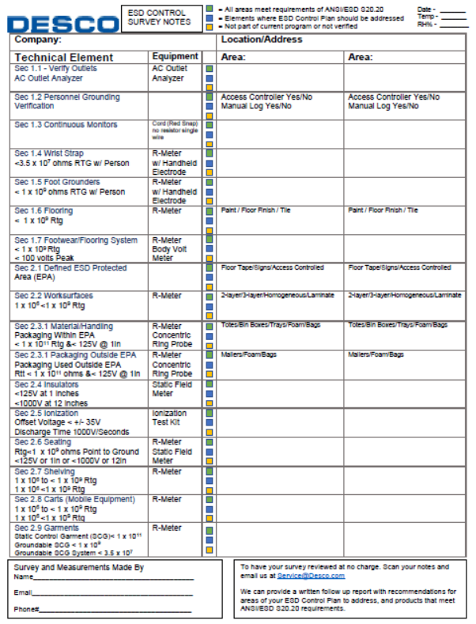
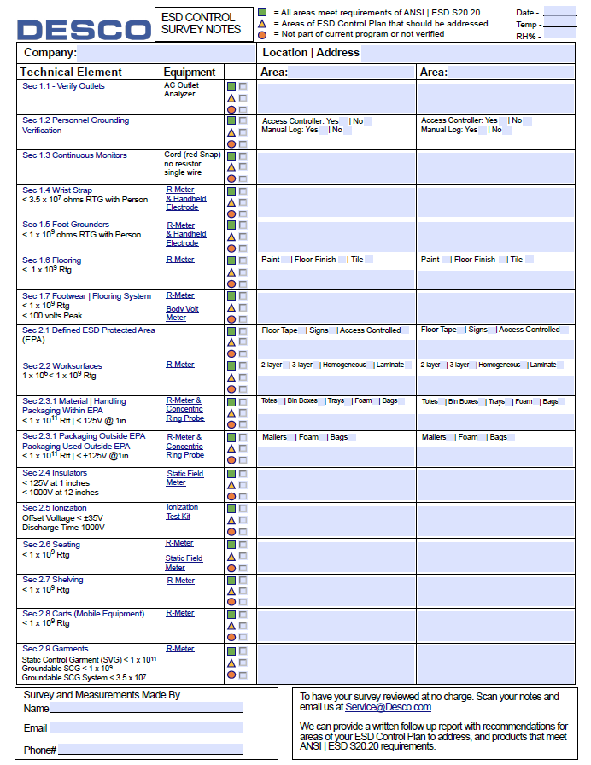
1. Fill out form digitally
or
2. Print and fill out by hand
Quick Check Section does not require measurements
Equipment needed to measure to the standard
Note: click for video instruction
Required Limits from ESDA S20.20
Email to Desco for evaluation

